Slide 1
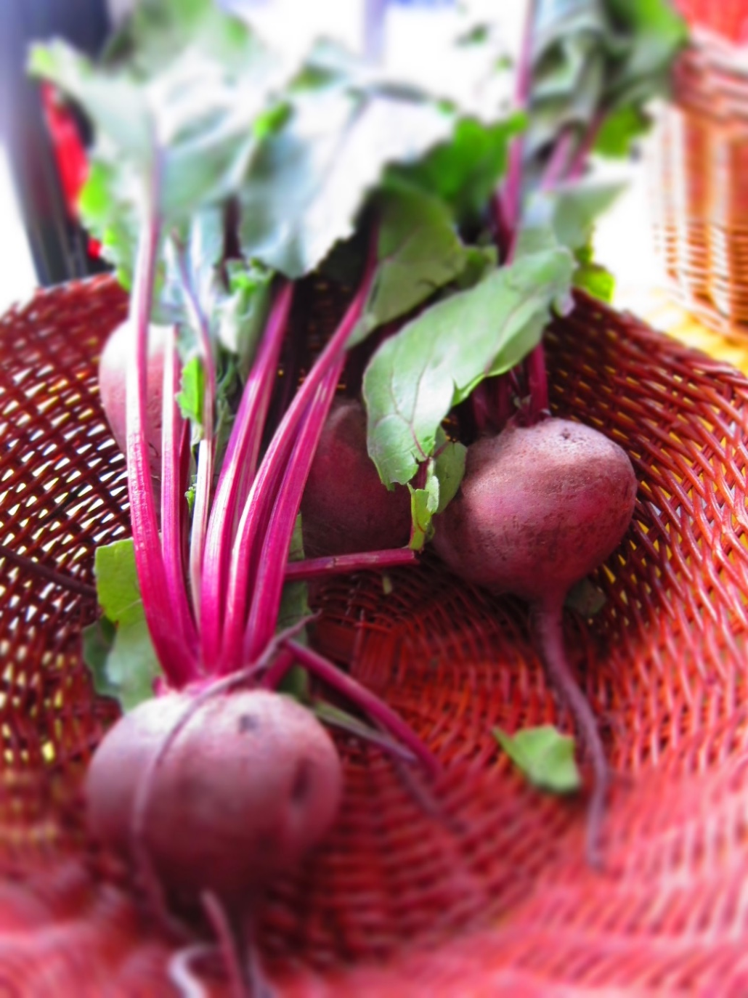
Market Garden Exploration
Is it right for you?

Slide 2
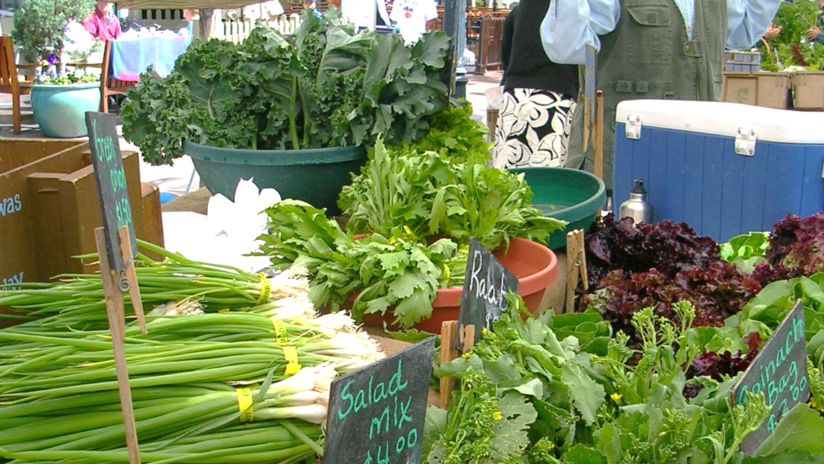

Slide 3
Market Garden Exploration Objectives
Determine if market gardening is right for you, your family and your land
01
Explore options for selling produce
02
Review garden start-up basics
03
Begin planning your garden for maximum productivity
04
Discuss harvest and handling
05

Slide 4
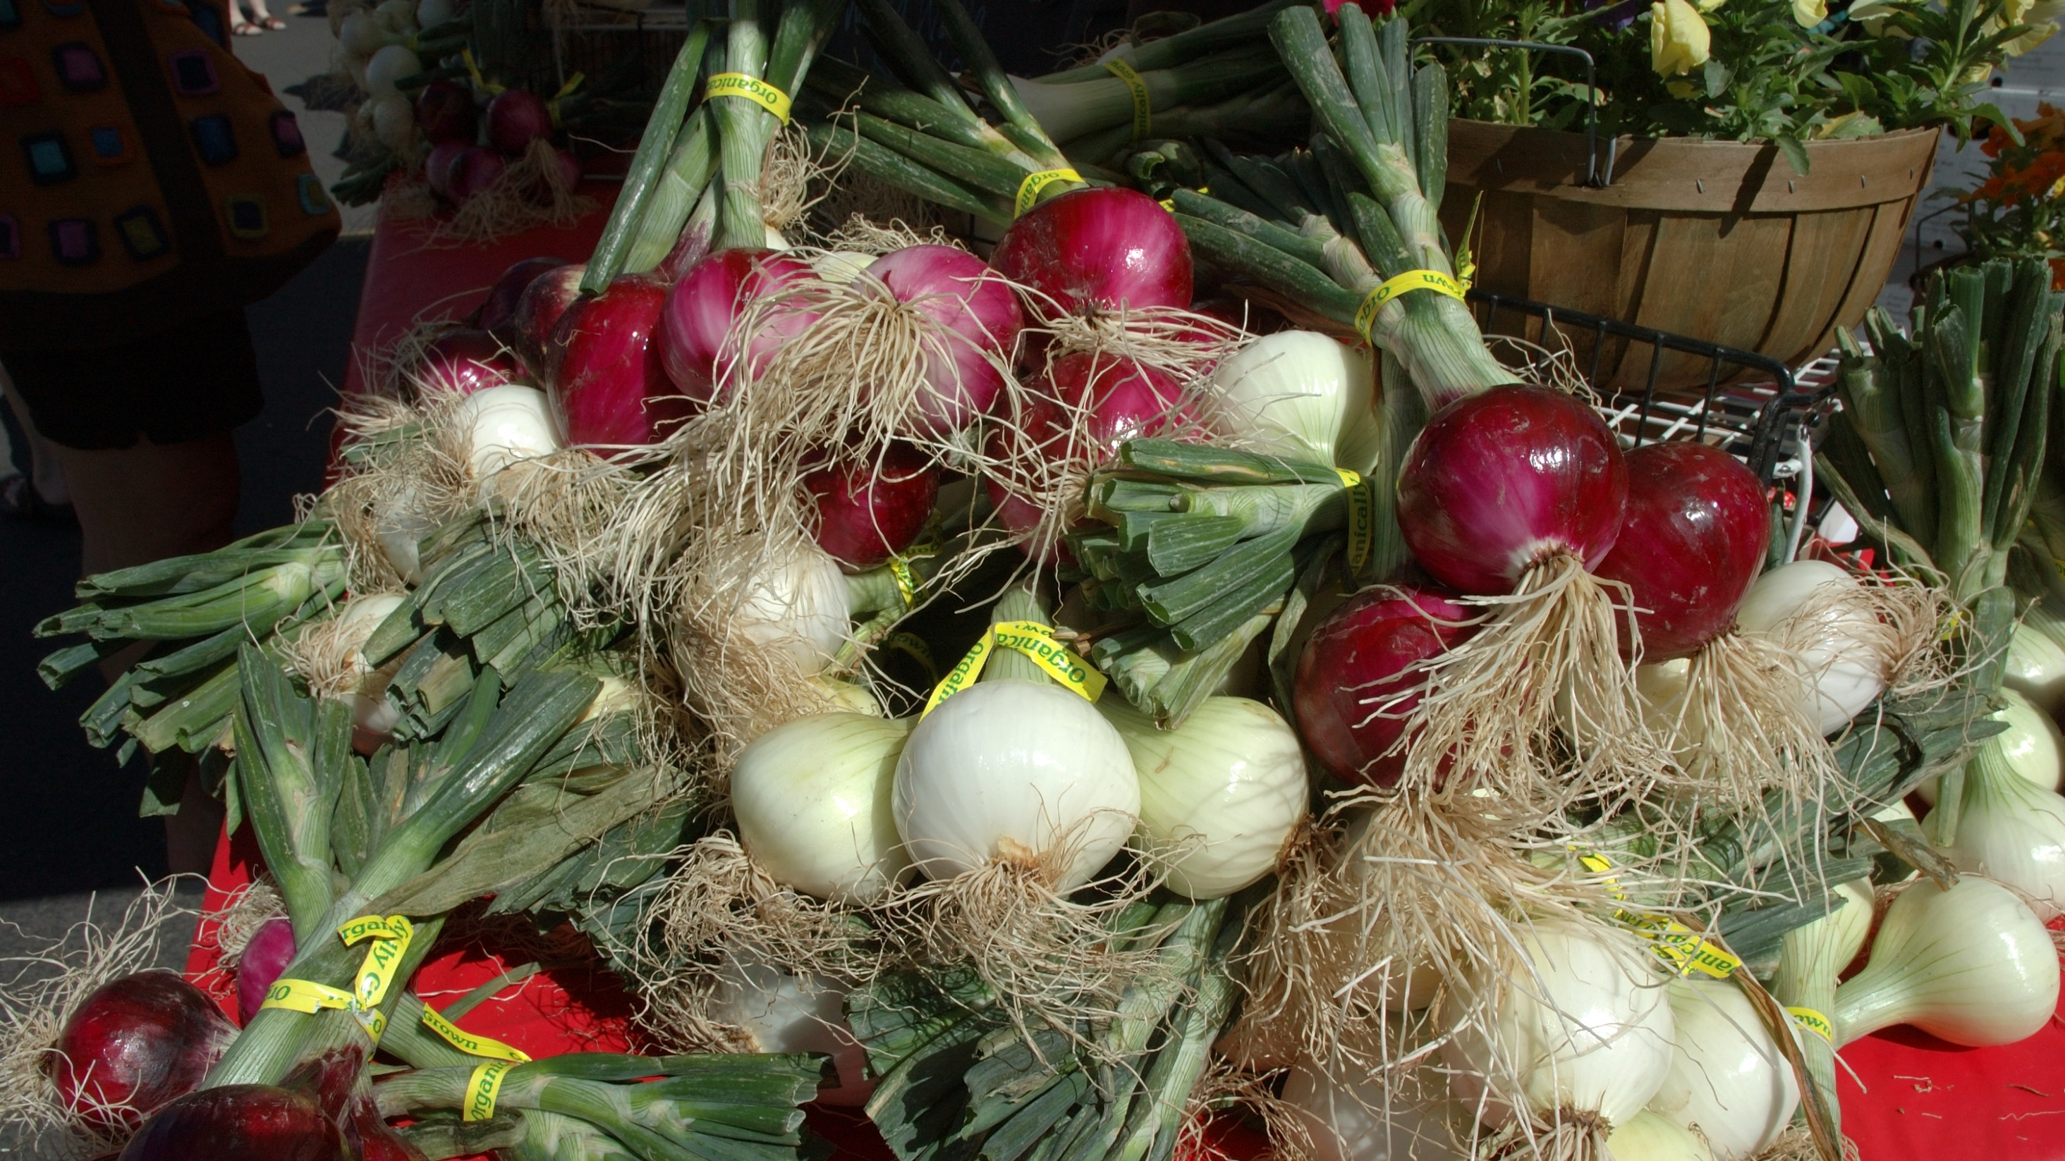
Getting Started
Exploring your Market Options

Slide 5
10 Ways to Market Produce
Direct Markets
Farmers’ markets
U-Pick
Farm stands
Weekly Subscription
Community Supported Agriculture (CSA)
AgriTourism
Mail order or Internet sales
Intermediated Markets
Grocery stores & retail co-ops
Restaurant sales
Caterers
Institutional sales
Schools, hospitals, food service
Food hub
Notes:
Let’s start by going over the 10 most common ways to direct market your products. We will go into each of these marketing venues in more detail.

Slide 6
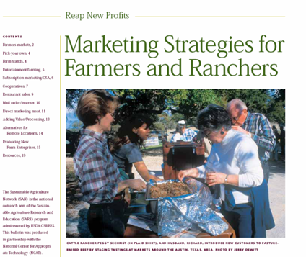
The Direct Marketing Approach
Consider Direct Marketing to:
  Capture more profit
  Reduce risk as you learn skills
  Develop unique product identity
www.sare.org
Notes:
What is direct marketing? Marketing a product in a way that involves the farmer as the direct source for the end user. In this way, the middleman, broker, wholesaler, etc. is eliminated in the buying chain. The farmer assumes more of the work in making that connection but also receives a higher percentage of the total value of the product. Many farmers are processing and distributing their products direct to restaurants or retail store, therefore capturing more of the consumer dollar.
In addition, the customer is often looking to know more about their food, and getting to know and purchase directly from the farmer growing their food has a increased appeal to many.
It is not that small acreage farmers cannot sell their crop or livestock products through a broker or to a wholesale entity. In fact, many producers of specialty or niche products may find that selling through a broker is a much more lucrative venue for selling due to volume purchasing. These products will generally be processed food products, with a shelf life and a unique identity (huckleberries jam from Idaho, Organic frozen vegetables from Stalbush Island Farms, or natural beef from Oregon County Beef).

Slide 7
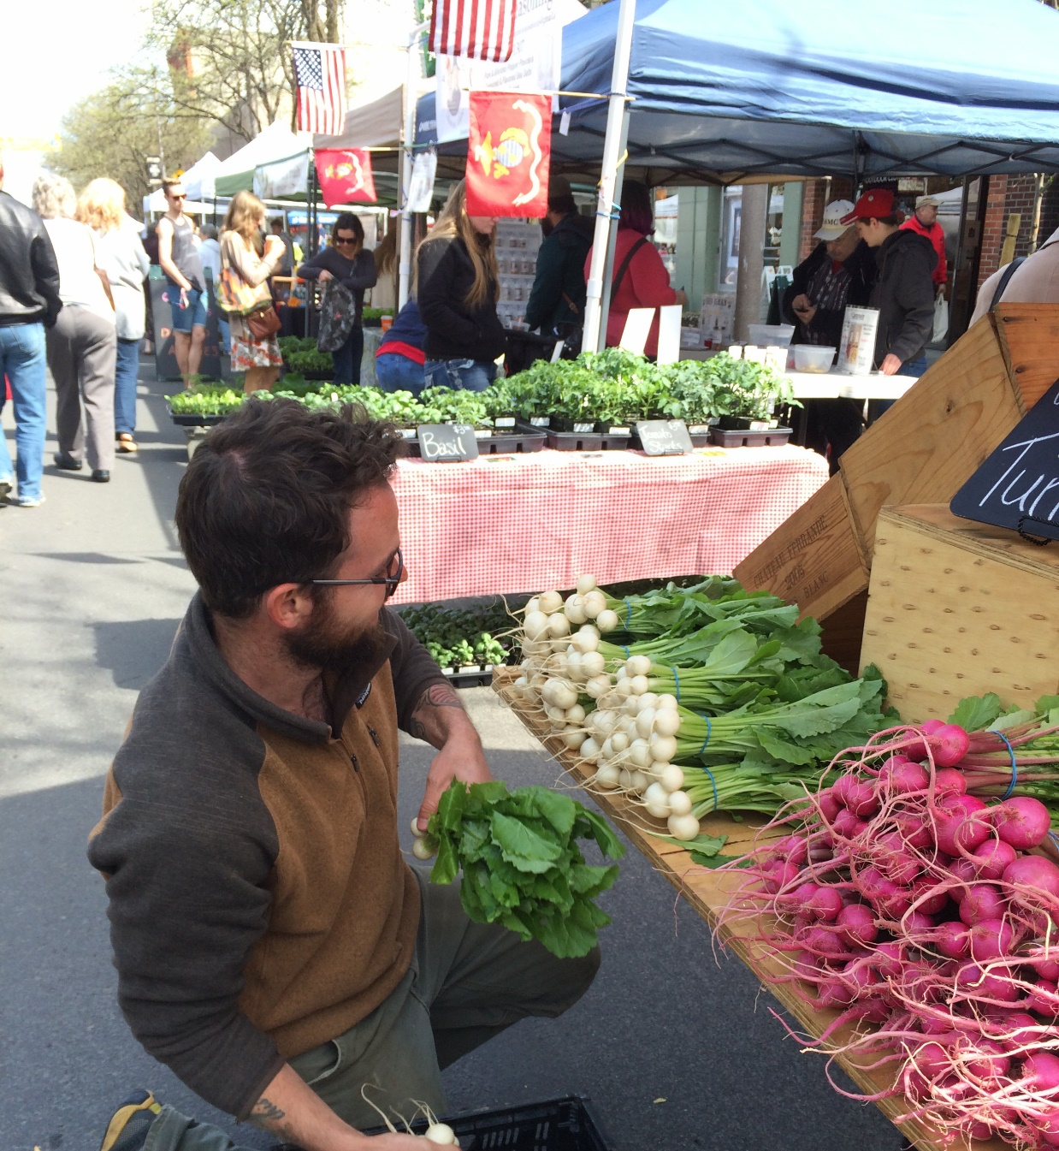
Skills Required of Direct Marketers
People skills - “Relationship marketing”
Marketing skills
Intensive production knowledge, experience
& management
Ability to produce the highest quality of product
Notes:
Direct marketing is another aspect of farming and very different than the production side. It involves a different set of skills. One of the most important of the necessary skills is being able to work with customers on a one–to-one basis. People skills are as essential as production skills. Having to market your own product adds another layer of management to the complexity of your operation.
Because you have direct contact with the consumer you will want to have a high quality product. That is your key to keep customers coming back week after week or year after year.

Slide 8
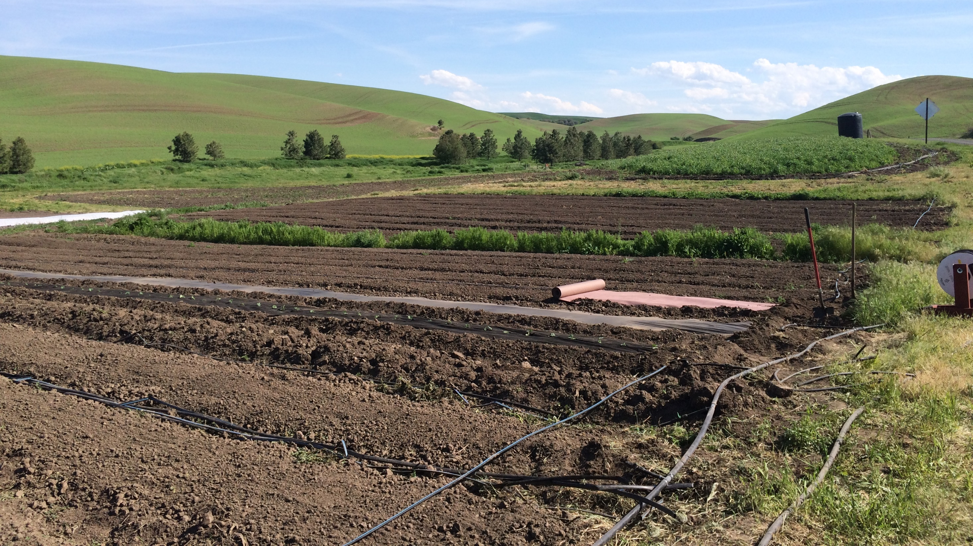
Inventory your Resources
Determine what you have so you can see the possibilities

Slide 9

Consider your Resources
Human
Financial
Land
Climate
Physical
Market
Notes:
There is no purpose in trying to start any enterprise before you have a clear inventory of your current resources. It is THE starting point. Know what you have – then know what you need – then start planning how you will get from A to B.

Slide 10
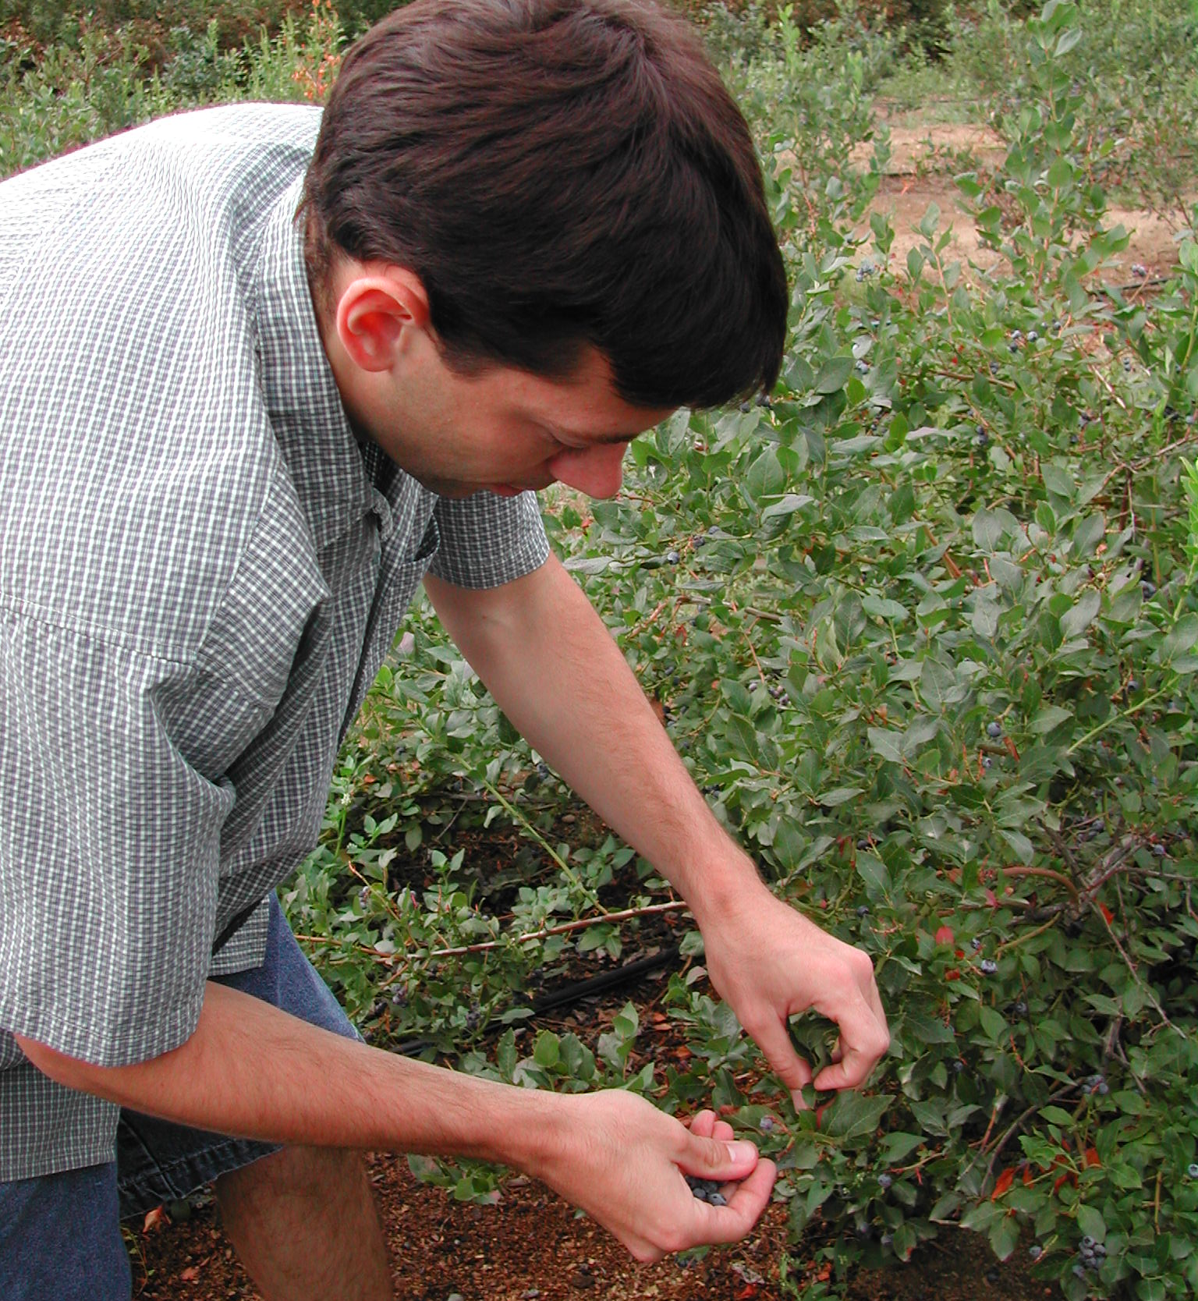
Human Resources Skills & Interests
Personal (and family) interests
Experience/skills that have prepared you for farming or other small acreage venture
Notes:
Start with yourself (and your family or potential partners, if appropriate). What are your interests? What are your goals for the farm – in terms of economic returns, environmental protection and quality of life?
We addressed this in the section on whole farm planning – now we are putting it all together to detail what the current human resources could be applied to the farm.
What are the skills for labor, management, marketing or any other aspect of the business that you and each member of your family or partnership can contribute to make things happen?

Slide 11
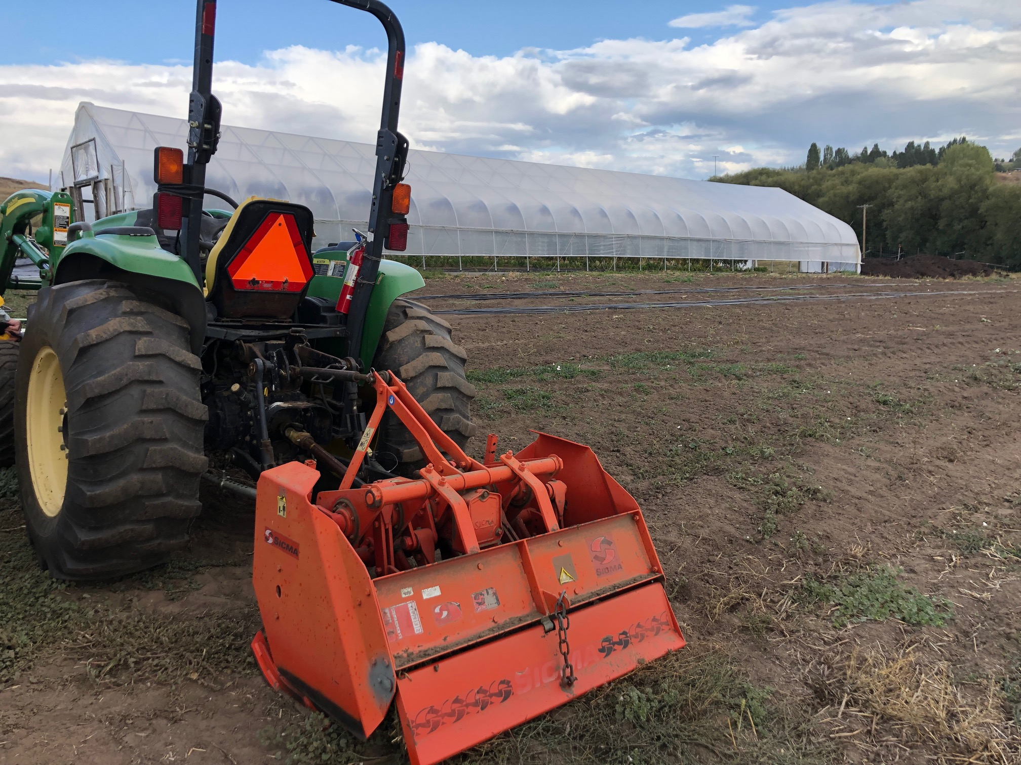
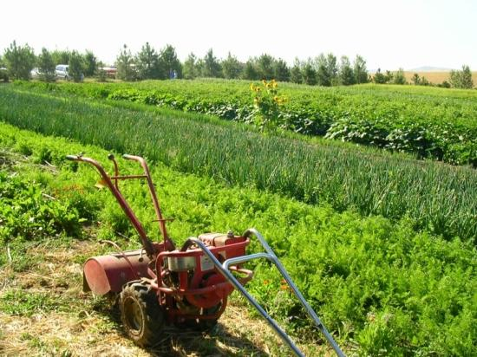
Your Financial Resources
What you have in mind…
What you can afford…
Notes:
Again – you have to keep your mind on the goal for your farm. But a look at your current financial capital and potential for loans, borrowing, working and saving needs to be evaluated. Many things can be improvised for start-up and improved over time as money is returned to the business.

Slide 12
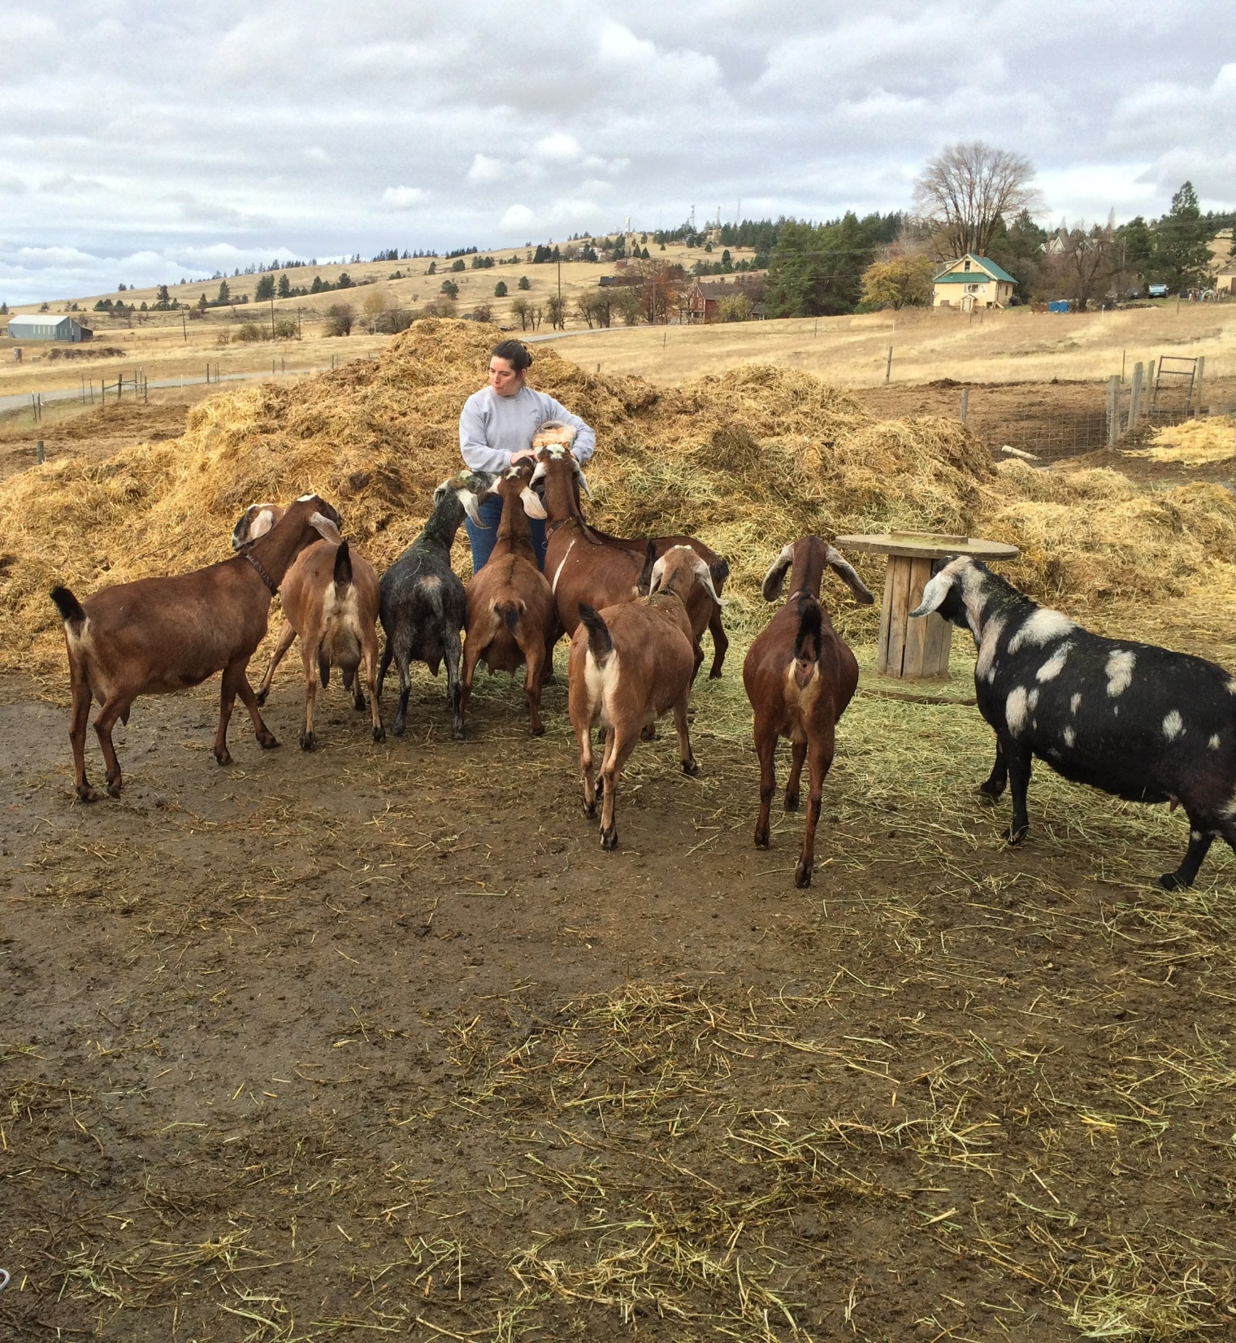
Your Natural Resources
Land
Soil
Water
Climate
Notes:
Inventory details of your land ( slope, aspect and current vegetation), the climate (and microclimate influences), as well as water sources, volume and seasonal variations.
For Idaho, a great reference for some of the Climate Data is including in: Specialty Farming in Idaho: Selecting a Site available on-line at:
http://info.ag.uidho.edu/pdf/EXT/EXT0744.pdf

Slide 13
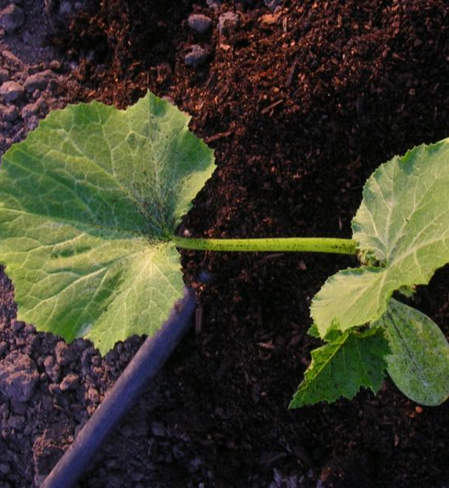
What Do Gardens Need?
Do You Have the Essentials?
Soil
Water
Sunlight
Nutrients

Slide 14
Physical Resources
Buildings – number, uses, condition
Greenhouse and/or hoophouse for season extension
Harvest shed, wash stations, packing shed
Storage
Equipment – condition, uses
Tractors, tillers, spreaders, seeders, harvesters
Spray equipment
Irrigation equipment
Harvest equipment, tools
Market tables, canopies, transportation
Other??
Notes:
What do you currently have for buildings? Are they currently being underutilized?
Buildings – details of condition and potential uses
Fencing – type and use, age and condition
Equipment - tractors and tools, but also irrigation and mechanical devices
Well location
Assess materials on hand for building.
Consider sources of used supplies and equipment

Slide 15
Market Resources
Are you located close to markets?
Is demand present?
What is your competition?
Where is your niche?
What potential exists for further expansion/new products?

Slide 16
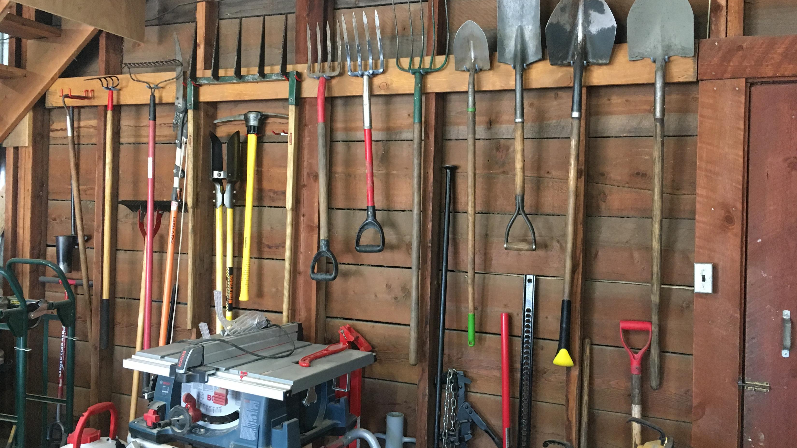
Setting Goals
Your roadmap to success in any garden enterprise

Slide 17

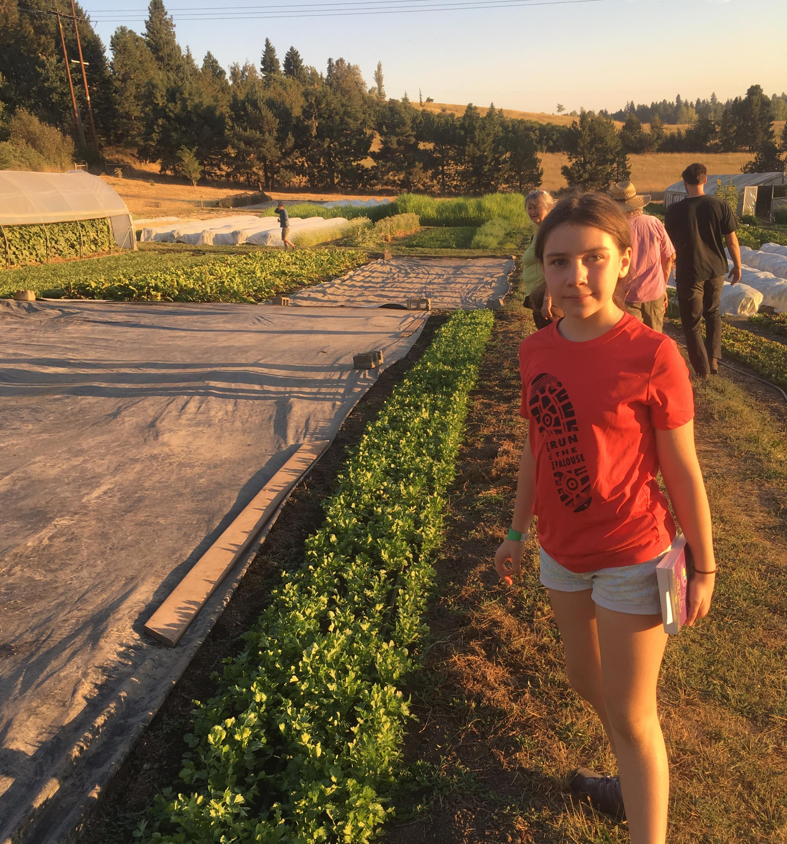
What are Your Goals for?
  Farm productivity
  Land sustainability
  Financial gain
  Quality of life
  Family
  Long term & short term
Notes:
If someone tells you he just wants to be “happy” do you know what that means to him? NO. So if someone tells you they want to have a successful farming operation – do you know what that means? NO. This is because our own definitions of success are built on our personal and family values and beliefs.
If we judge a farm’s success only on the money it is bringing in to the family – is that an accurate assessment? It depends!
This is the time to start thinking about your farm and what you really want for your future. You can look at the near future next five years and also down the road to the next generation.
Ask your self some questions about the following.

Slide 18
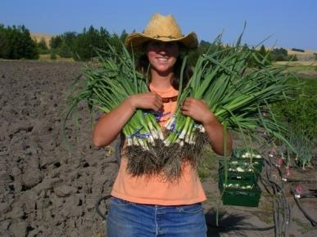
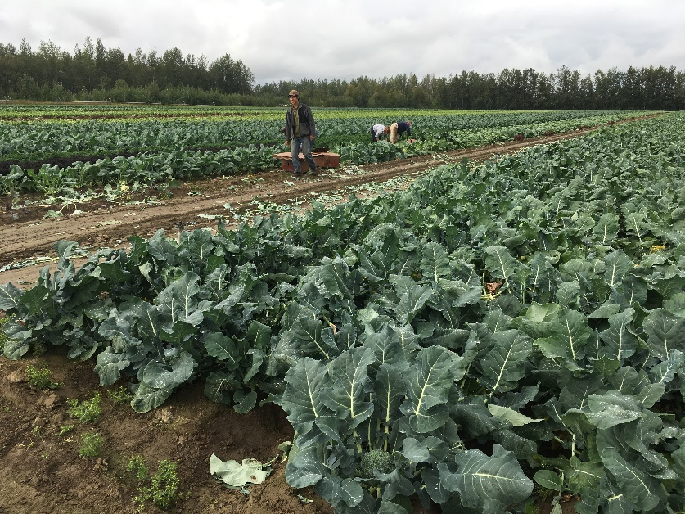
Financial Goals
+
+
What is your definition of financial success?
What other values/benefits are supplied by the farm operation?
Notes:
What is YOUR definition of financial success? How much money do you need to live in a manner that provides you a comfortable life? Is this a career to support a family or to enhance another paycheck?

Slide 19
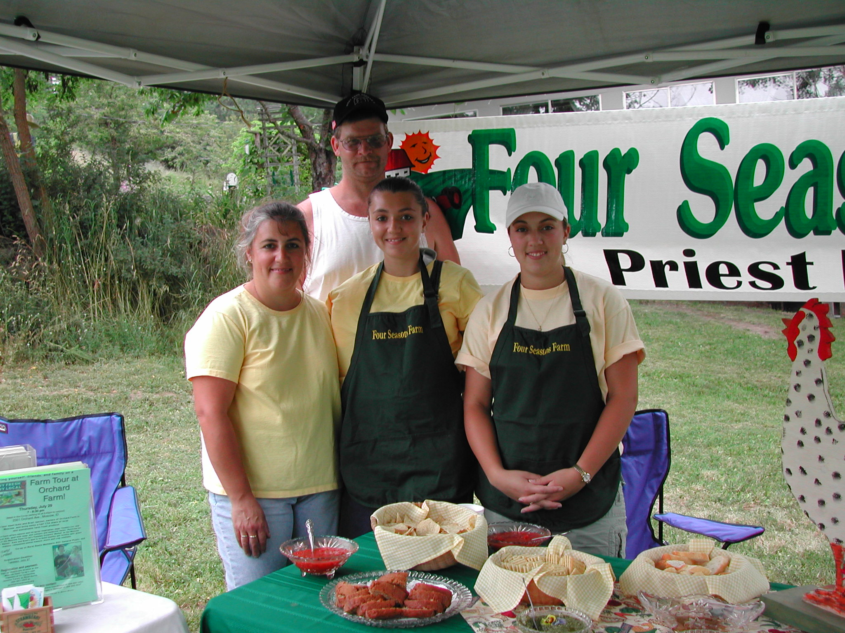
Quality of Life
The measure of shared value and satisfaction you and your family attach to the various features of place, the environment and working
Notes:
Here is where values come in. What is it worth to you to raise your kids on the farm? What does it mean to work side by side with your spouse everyday? What is the value of producing your own food?

Slide 20
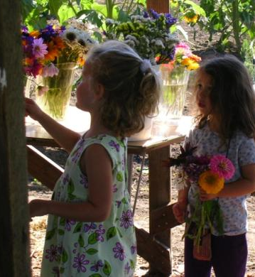
Goals for Your Family
The importance of family to farming can NOT be overlooked
  Farming is a lifestyle
  You don’t leave home to go off to a job
  The people who are most important to you are often directly affected by the decisions you make
Notes:
Don’t forget your family. Farming is different than most professions – it is part business and part your lifestyle. Your family has a vested interest in decisions you make.

Slide 21
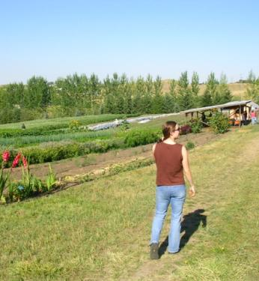
Without Goals…
  We react to what happens… leading us wherever the new path might lead
  We often spend more time reacting and less time creating
Notes:
Many of us go through life without intentional goals. We react to external events and people to happen upon where we are going. It is not a very efficient way of getting where we want to be and in a business situation may prove fatal.

Slide 22
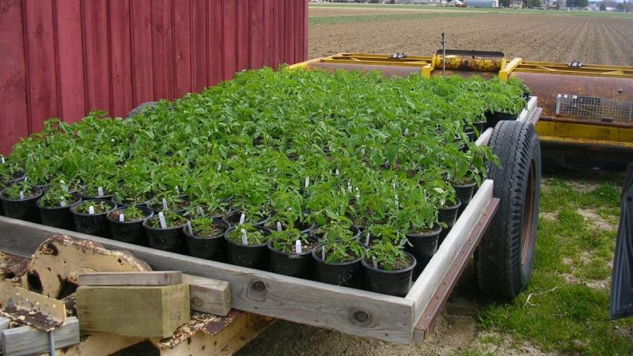
Getting Started
Planning and Planting Fundamentals

Slide 23
Market Garden Success
Wise planning
1
Choosing the right crops
2
Using season extension techniques, succession planting & more
3
Diversifying your crops and markets
4
Keeping careful records
5
Staying abreast of relevant regulations
6

Slide 24

What to Grow? How much?
What are your financial/marketing/
eating goals?
How much land is available?
How much labor is available?
What do you grow well?
What grows well on your land?

Slide 25
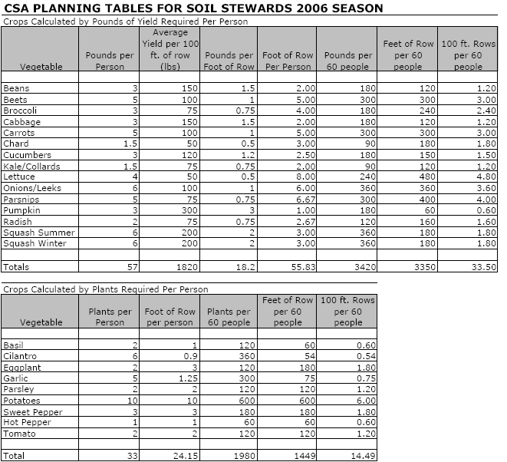
Planning Crop Production
Use published tables of per capita use/expected yields
Use your own experience/research
What does your market or family demand?

Slide 26
Choosing Your Crop Portfolio
Good seed is the foundation
How do you read a seed catalog?
How do you make selections?
What are some good sources of quality seed?
Can I save my own seed?

Slide 27

What Do You Plant, When?
When do you want to begin marketing (or eating)?
How do you time your crop production?
How do you plan for successive/repeated harvests?
How do you extend the season?

Slide 28
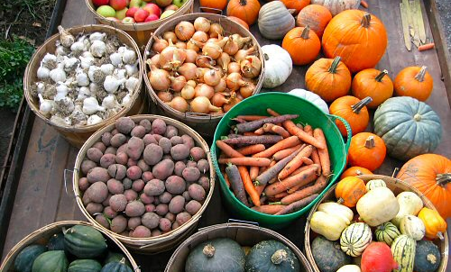
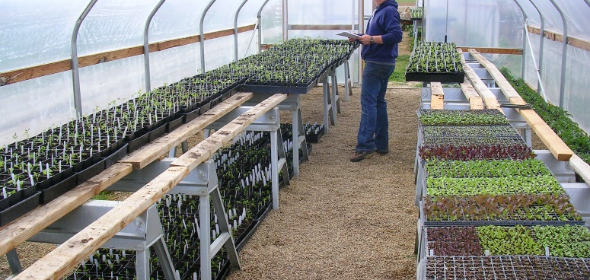
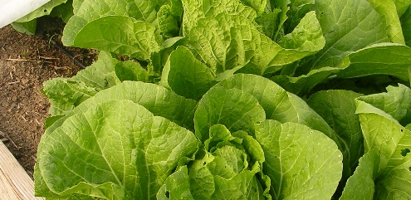
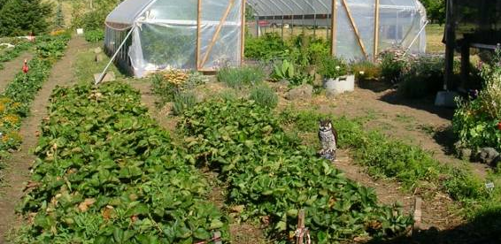
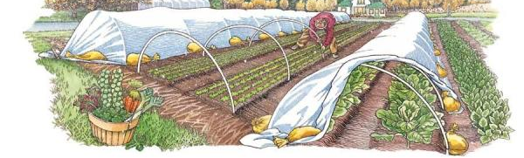

Slide 29
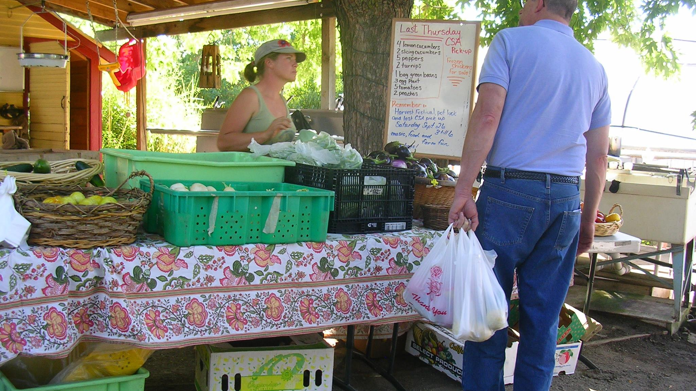
What will be your farm story?

